Slide 1
Sea Wave Energy

Slide 2
INTRODUCTION
The energy in ocean waves mainly comes in an irregular and oscillating form at all times of the day and night.
Solar energy causes winds to blow over vast ocean areas, which in turn cause waves to form, gather, and travel huge distances to the shoreline of continents.
The wave height, period, and direction are primarily dependent on the wind properties (speed, direction, and duration) and also the geometry of the sea (fetch length and depth).
There is surprisingly little loss of energy in deep-water ocean waves, so as they travel to distant shores they continue to collect more and more wind energy.
However, as waves approach relatively shallow water, their energy is greatly dissipated due to ground effects and this causes the dynamic, chaotic, and highly variable environment known as wave breaking close to shore.
Kinetic energy, the energy of motion, in waves is tremendous. An average 4-foot, 10-s wave striking a coast puts out more than 35,000 horsepower per mile of coast.
Waves get their energy from the wind. Wind comes from solar energy. Waves gather, store, and transmit this energy thousands of miles with little loss. As long as the sun shines, wave energy will never be depleted. It varies in intensity, but it is available all the times.

Slide 3
MOTION IN THE SEA WAVES
A wave is a forward motion of energy and not the water in deep sea. In true sense, the seawater does not move forward with a wave. Waves are characterized by the following parameters
1. Crest: The peak point (the maximum height) on the wave is called the crest.
2. Trough: The valley point (the lowest point) on the wave is called the trough.
3. Wave height (H): Wave height is a vertical distance between the wave crest and the next trough (m).
4. Amplitude (a): It is defined as H/2 (m).
5. Wave length (l ): It is the horizontal distance either between the two successive crests or troughs of the ocean waves (m).
6. Wave propagation velocity (v): The motion of seawater in a direction (m/s).
7. Wave period (T): It measures the size of the wave in time(s). It is the time required for two successive crests or two successive troughs to pass a point in space.
8. Frequency (f ): The number of peaks (or troughs) that pass a fixed point per second is defined as the frequency of wave and is given by f = 1/T (cycle/s).

Slide 4
DEVICES FOR HARNESSING WAVE ENERGY
There are three basic technologies for converting wave energy to electricity. They are as follows:
1. Terminator devices: It is a wave energy device oriented perpendicular to the direction of the wave and has one stationary and one moving part. The moving part moves up and down like a car piston in response to ocean waves and pressurizes air or oil to drive a turbine. An oscillating water column (OWC) converter is an example of terminator device. These devices generally have power ratings of 500 kW to 2 MW, depending on the wave parameters and the device dimensions.
2. Attenuator devices: These devices are oriented parallel to the direction of the waves and are long multi-segment floating structures. It has a series of long cylindrical floating devices connected to each other with hinges and anchored to the seabed. They ride the waves like a ship, extracting energy by using restraints at the bow of the device and along its length. The segments are connected to hydraulic pumps or other converters to generate power as the waves move across. Pelamis wave energy converter is one of the known examples of attenuator devices.

Slide 5
3. Point absorber: It is a floating structure with parts moving relative to each other owing to wave action but it has no orientation in any defined way towards the waves instead absorbs the wave energy coming from any direction. It utilizes the rise and fall of the wave height at a single point for energy conversion. The pressurized water creates up and down bobbin-type motion and drives a built-in turbine generator system to generate electricity. AquaBuOY WEC is an example of point absorber devices.
4. Overtopping devices: These devices have reservoirs like a dam that are filled by incoming waves, causing a slight build-up of water pressure. Gravity causes released water from reservoir to flow back into the ocean through turbine coupled to an electrical generator. Salter Duck WEC is the example of overtopping devices.

Slide 6
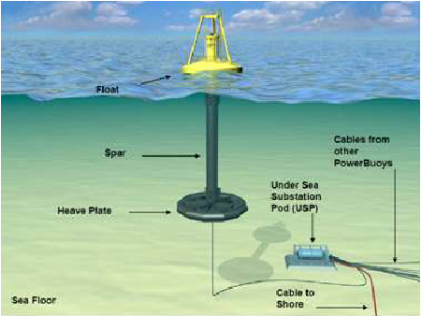
Buoys and floats
Buoys and floats are designed to float on the surface of a body of water, or are supported below the water's surface to mark a location. They are used in marine navigation, boat mooring, nautical communications, and weather observation applications.

Slide 7
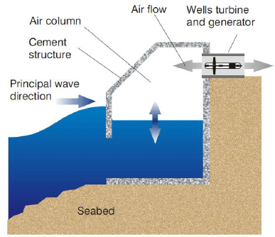
Oscillating Water Column Devices
Oscillating water column devices are partially submerged hollow structures that form an air chamber with an opening underwater. As the waves rise and fall, the air trapped within the chamber compresses and expands, allowing the turbine to rotate and generate electricity.

Slide 8
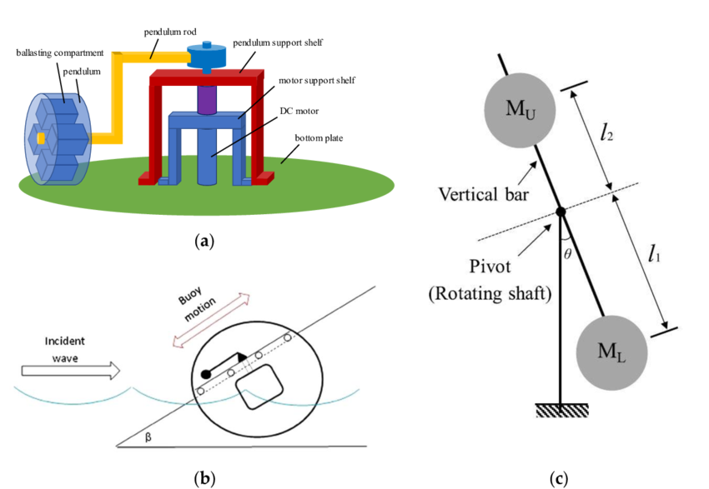
Pendulum System
The wave power device composes of pendulum mechanism that converts wave energy into mechanical energy and energy storage mechanism where the mechanical energy is transferred quantitatively to generator.

Slide 9
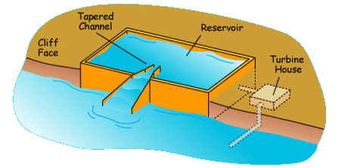
TAPCHAN (Tapered Channel)
The wave energy is converted to potential energy in an on-shore water reservoir. The generation of electricity is carried out by standard hydroelectric power plant technology. The conversion device is entirely passive and has no moving parts.

Slide 10
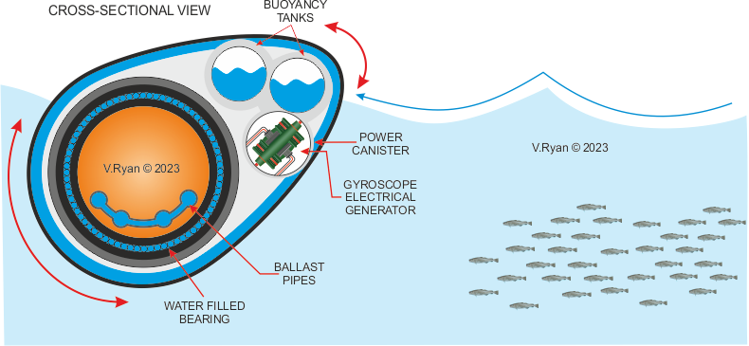
Salter’s Duck System
Salter's duck, also known as the nodding duck or by its official name the Edinburgh duck, is a device that converts wave power into electricity.

Slide 11
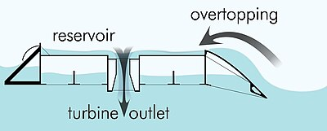
Offshore Wave Dragon System
Wave Dragon is a unique and scalable technology based on proven technologies, combining hydro turbines and wind turbines, resulting in highly cost-efficient energy production. It’s a large stable platform, essentially a floating hydro power plant, offering remarkable reliability in power production and maintenance.

Slide 12
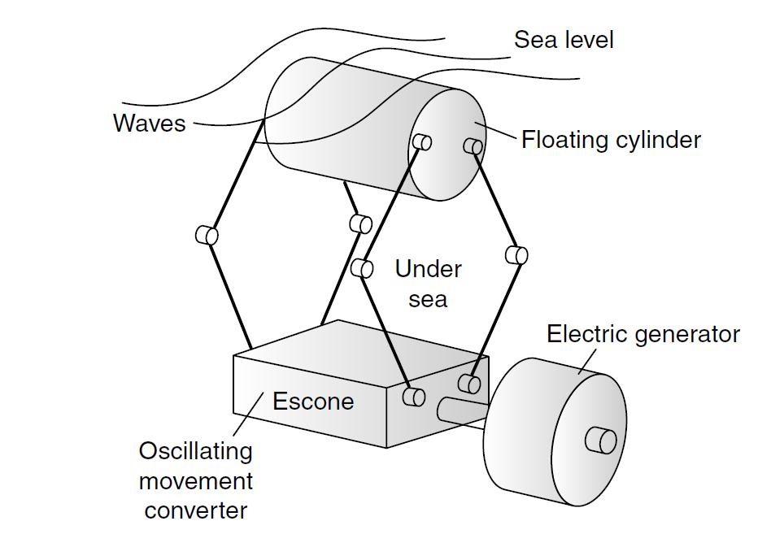
Bristol Cylinder
The Bristol cylinder operates under the sea level. It consists of a floating cylinder that collected the wave’s movement. The cylinder is mechanically connected to the energy unit by flexible joints and rods. The rods are moving slowly with cylinder and the reciprocating motion is transferred to the axels in converter unit.

Slide 13
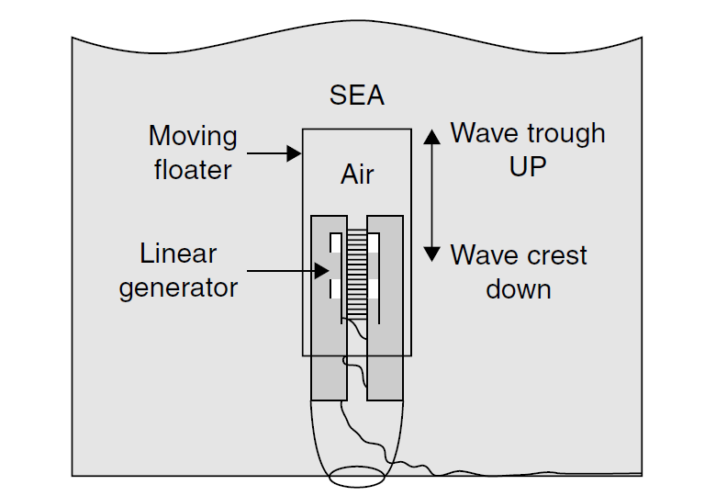
Archimedes Wave Swing Devices
A fully submerged heaving device (Archimedes Wave Swing), consists of an oscillating upper part (the floater) and a bottom-fixed lower part (the basement). The floater is pushed down under a wave crest and moves up under a wave trough.

Slide 14
ADVANTAGES AND DISADVANTAGES OF WAVE POWER
Advantages
1. Sea waves have high energy densities and provide a consistent stream of electricity generation capacity.
2. Wave energy is clean source of renewable energy with limited negative environmental impacts.
3. It has no greenhouse gas emissions or water pollutants.
4. Operating cost is low and operating efficiency is optimal.
5. Damage to ocean shoreline is reduced.
Disadvantages
1. High construction costs.
2. Marine life is disrupted and displaced.
3. Damage to the devices from strong storms and corrosion create problems.
4. Wave energy devices could have an effect on marine and recreation environment.

